Slide 1
Welcome to the Waltrip Rambling Roses Dance Team Parent’s Meeting

Slide 2
The Purpose of the Parent’s Club
To support the members of the Waltrip Rambling Roses

Slide 3
Roses Leadership
Shelley Gillis, Director
Alondra Peña Nestor, Assistant Director
Dance/Military Officers & Social Officers

Slide 4
Get Connected
Remind App
Roses Page on the website

Slide 5
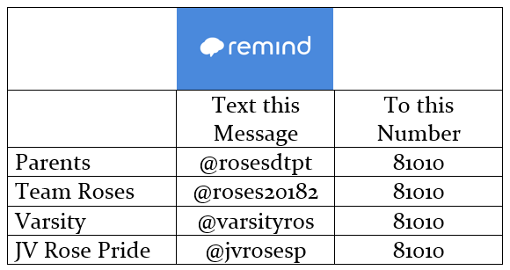
A message goes out every Sunday or Monday between 5 & 6 pm

Slide 6
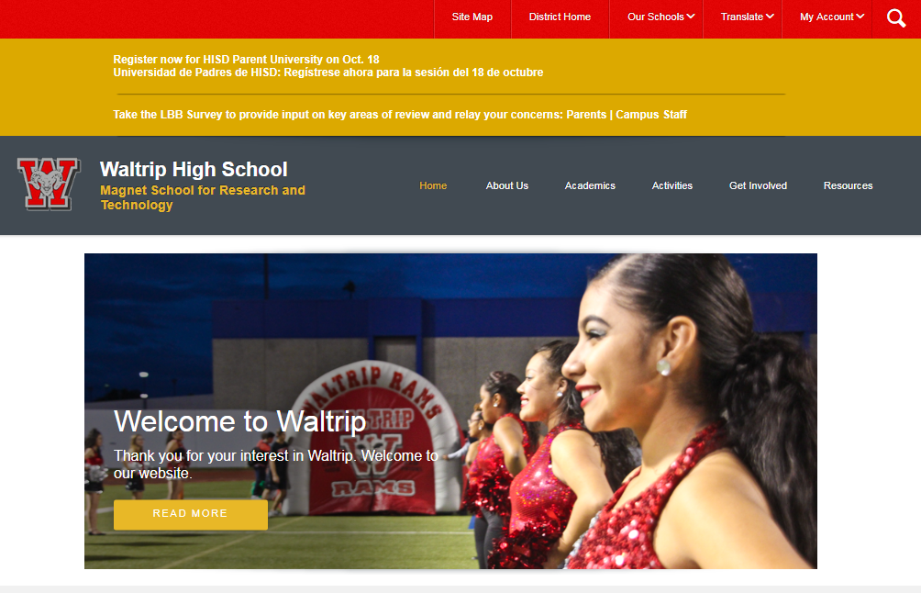
Waltrip Website

Slide 7
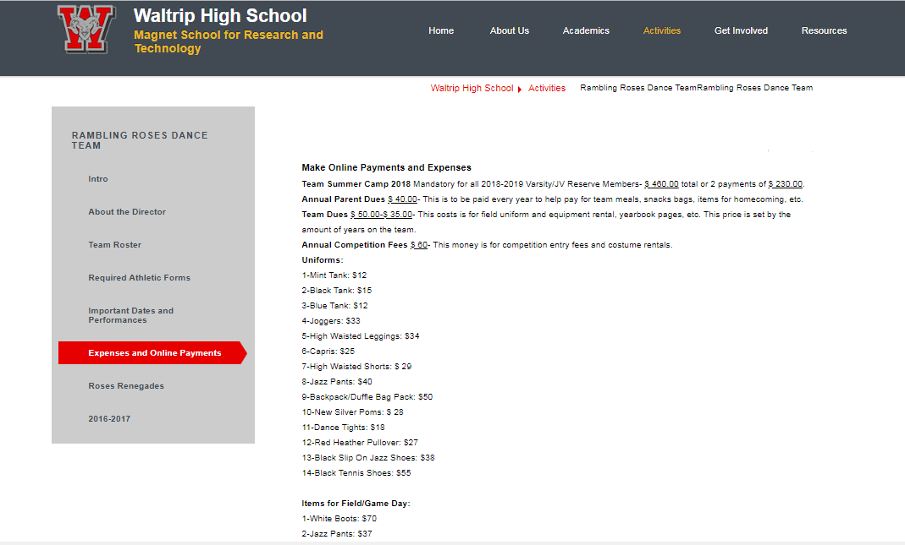
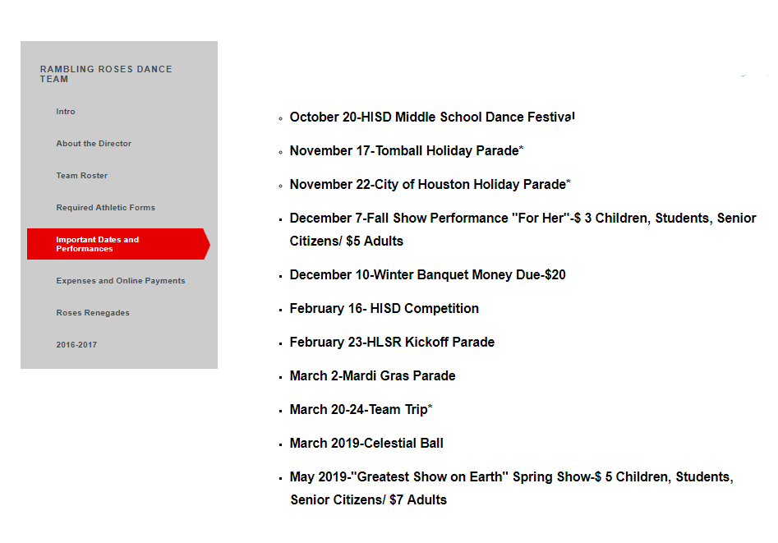
Roses Page
Expenses & Payments
Important Dates

Slide 8
A Year in the Life of a Rose
June-Officer Camp/Planning
July-Officer Planning Organizing/ Varsity Practice
August-Team Camp, Fish Camp, Ram Rally
September-Football Season-Halftime/Pep Rallies
October-Football Season-Halftime/Pep Rallies
November-Football Season-Halftime/Pep Rallies, Homecoming, Learn Fall Show, Thanksgiving Parade (Varsity)
December-Fall Show/Learn & Audition Competition, Winter Banquet, Finals
January-Competition Rehearsal
February-Competition Rehearsal, HISD Competition, Black History Performance, HSLR Parade Varsity
March-Officer Auditions, Celestial Ball, Mardi Gras Parade (Varsity)
April-Spring Show Rehearsal, Team Auditions
May-Spring Show

Slide 9
Fundraising Events
Brochure Sales-still ongoing
HISD MS Dance Festival-October 20
Homecoming Assembly Show (Daytime)-November 1
Fall Show (Evening)-December 7
HISD Competition-February 16 (February 15 Setup)
Spring Show-May 2019

Slide 10
Upcoming Event
HISD Middle School Dance Festival- October 20 8 am- 6 pm
Food Sales-
Pre paid meals
Possible Options- $6-$8
Hartz-Chicken Strips and roll-$3
Chic Fil A-Chicken Strips
Canes-Chicken Strips
Salad
Every Entrée comes with chips, water and cookie
Snack Bar-
Drinks
Chips
Candy
Fruit snacks
Granola Bars
Fruit

Slide 11
The Plan
A parent will be over each school’s order
Each school will have a set of Roses that will be assigned to that school
The snack bar will also need a parent to be in charge of the snack bar and the Roses that are assigned. (possible shifts)

